Slide 1
Example Mapping A BDD process
Thanks to Enlighten UK & this is an experiment

Slide 2
Activities and Outcomes
Business
goal
Features
Examples
Executable
specifications
Stories illustrated with
concrete examples
Guide development
and testing
User Story
Feature broken down
Into user stories
Notes:
This shows high level flow.
Features have business value – for delivery broken into user stories
Conversations used to illustrate stories with examples
Examples refined into executable specifications

Slide 3
User Stories
A common mistake made by many agile teams is to consider a user story as a requirement, with ACCs as tests.
User story should be conversation starter
PO, developers, testers build shared understanding of what is to be built
Outcome of conversations for teams practicing BDD is:
Shared understanding
Set of concrete examples that illustrate key outcomes of story
These examples are then refined to form executable specifications/acceptance criteria

Slide 4
From Stories to Examples
It can be difficult to extract examples for user story
Process is unstructured
Takes too long and becomes boring
This workshop introduces a technique known as Example Mapping
Keeps conversation short yet productive
Forms the basis from which executable specifications can be defined

Slide 5
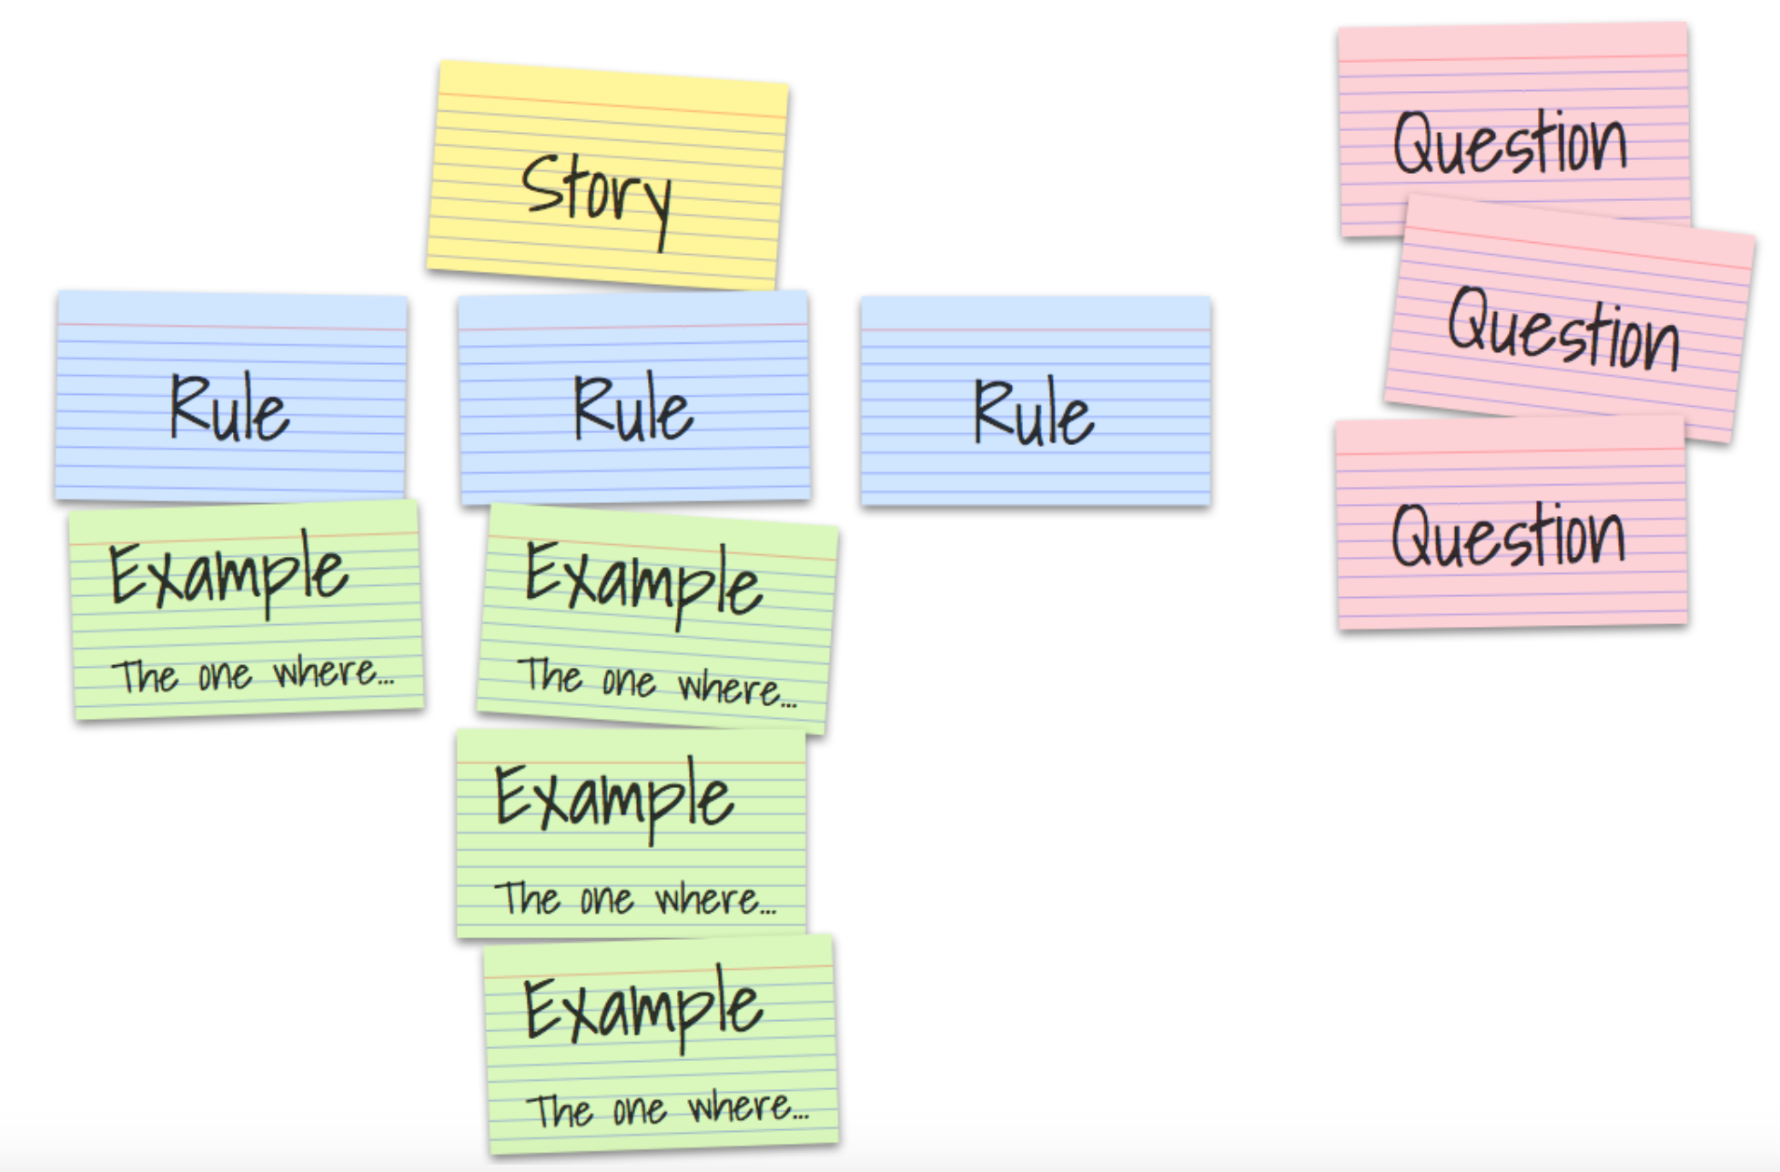
Example Mapping Map

Slide 6
Example Mapping
Examples are a great way to explore user story and problem domain
Also form basis for acceptance tests
As conversation progresses important items that should be captured include:
Rules
Agreed constraints on the story
Questions
Nobody involved knows the answer – or assumptions made so as to progress
New stories
Discovered or sliced as conversation progresses

Slide 7
How It Works
Use a 4 coloured index cards to capture key information
Cards are completed as conversation progresses and laid out in a map
Step One: Write story on a yellow card and place on table
Step Two: Write acceptance criteria or rules on blue card
Place under yellow story card
Step Three: For each acceptance criteria or write one or more examples on a greed card
Place under relevant blue card
Any questions that cannot be answered are written on a red card
Keep going until group is satisfied scope is clear or time is up
Next step (later) – use data to write cucumber tests (with data tables) to cover these examples
With stricter Given, When , Then syntax

Slide 8

Who Is Involved In Example Mapping
Minimally session should have:
Product Owner
Developer
Test focused developer
Anybody else involved in the story should also attend
E.g. user experience member
In early stages of adopting example mapping then facilitator can be useful
Completes cards

Slide 9
Example Mapping Session Purpose
Product Owner
User Story
Examples
+
Developer
Test focused
developer

Slide 10
Instant Feedback
Example mapping quickly builds picture of understanding of the story
A large amount of red highlights there is a lot of unknowns for the story
A large amount of blues highlights there is a lot of work to do
Is the story too big?
Slice the story
A rule with many examples means rule may be overly complex
Is there really more than one rule at play here?

Slide 11
Time Boxing
It is important to time box the Example Mapping activity
A well understood story should be mappable in 45 minutes maximum
Initially it will take longer
As you learn and work out how it works for you
More than 25 minutes once established indicates:
Story is too big or
Story has too much uncertainty

Slide 12
Example Schedule
Suggested meeting structure is:
5 minutes: PO presents story and initial rules they have defined
Enough detail to begin conversation
10 minutes: brainstorming of rules, questions and examples
30 minutes: discuss and extract more examples, questions and rules

Slide 13
Benefits
Example Mapping helps to identify smallest pieces of behaviour in a story
Mapping story out enables:
Rules to be identified
Find core behaviour
Identify risks
Process behaves like a filter
Prevents big stories getting into sprint
Reduces chances of in-story surprises occurring
Timed boxed activity makes this highly efficient

Slide 14
Benefits (continued)
Example Mapping session output is a set of examples
Main objective of session is to reach a shared understanding of what is required to be done
Team can transform examples into executable specifications later
Cucumber tests – with data tables

Slide 15
Known Unknowns
Whenever a conversation struggles to generate an example then:
Not enough information is available
Maybe somebody is missing from the conversation
More research may be needed
A spike may need to be performed
Do not waste time in the meeting with many different opinions
Capture the uncertainty as a question and move on
Unknown unknown has been turned into a known unknown!

Slide 16
AIT MSC Project - All User Stories
Don’t test POJOs
Import – unit test file import logic
Import
Consistency check – going to look at this one today
User CRUDs – pretty straight forward USs , but consider this process
Queries – try example mapping
– get actual data for UI (and rest API)
Its about understanding the what – not just explicitly writing tests
Tests are an added benefit
Graphics / drill downs - different type of problem – see if can be applied
Where are you guys at now?

Slide 17
Consistency Check User story
As the System Administrator
I want to have incoming records checked for consistency
(i.e. valid date / time values, valid MNC / MCC combinations, valid Event IDs, Cause Codes etc.)
and have erroneous records highlighted and excluded
so that
"Only valid data is loaded into the system,
Count of erroneous events is generated,
And details of erroneous events are logged in the system"

Slide 18
Break User Story down
Take a few minutes

Slide 19
Break User Story down
Take a few minutes
Outline of user stories
Consistency check – variants
Log errors
Count errors

Slide 20
Consistency check User Story
Acceptance Criteria ---- Rules
Take a few minutes

Slide 21
Consistency check problem
Examples per rule
Take a few minutes

Slide 22
Consistency check problem
Examples
Suggestion
Use reference tables as they are!
And pick example base data

Slide 23
Consistency check problem
with the following eventCauseReference data
| cause_code | event_id | description |
| 0 | 4097 | Dummy text1 |
| 1 | 4097 | Dummy text2 |
| 0 | 4098 | Dummy text3 |
| 2 | 4098 | Dummy text4 |
Then results below should apply for base data eventID and cause code
| event_id | cause_code | result |
| 4097 | 0 | true |
| 4099 | 0 | false |
| 4098 | 99 | false |
| 4098 | 0 | true |
Examples
Suggestion
Use reference tables as they are!
And pick example base data

Slide 24
Consistency checks
Date
EventCause
FailureClass
UE Table
MCC-MNC Table
Null
Data formats
Ints and strings
“e.g. no text where numbers are expected”
Time units?
Imsi - google the spec
Hier 15-20#s
<Null>?

Slide 25
Questions
Reference tables
Do we check consistency – yes formats
Nulls

Slide 26
Consistency checks
A definite value of < null > for Failure Class or Cause code occurs where these values can’t be reliably established but the remainder of the Event details remain valid and should be displayed. “Null” can be displayed for these fields on the UI and an explanation in documentation and/or in UI that “these values can’t be reliably established for this valid event”. Hint there is one case of this in the second data set you get

Slide 27
Consistency check User Story
Background:
Given the following eventCauseReferenceTable data
| cause_code | event_id | description |
| 0 | 4097 | Dummy text1 |
| 1 | 4097 | Dummy text2 |
| 0 | 4098 | Dummy text3 |
| 2 | 4098 | Dummy text4 |
Scenario Outline: Event and Cause Code consistency check
When check incoming event with <event_id> <cause_code>
Then result should be <result>
Examples:
| event_id | cause_code | result |
| 4097 | 0 | true |
| 4099 | 0 | false |
| 4098 | 99 | false |
| 4098 | 0 | true |
Examples
To
Executable tests
Suggestion
Use reference tables as they are!
And pick example base data

Slide 28
Summary
Understand the user story
/ sub stories
Define real examples for real rules
And ratify with the PO
Can steer the way you develop-------BDD
You only write code for what is actually needed!
Executable specifications
Automatic tests

Slide 29
Consistency check problem
Background:
Given the following eventCauseReferenceTable data
| cause_code | event_id | description |
| 0 | 4097 | Dummy text1 |
| 1 | 4097 | Dummy text2 |
| 0 | 4098 | Dummy text3 |
| 2 | 4098 | Dummy text4 |
Scenario Outline: Event and Cause Code consistency check
When check incoming event with <event_id> <cause_code>
Then result should be <result>
Examples:
| event_id | cause_code | result |
| 4097 | 0 | true |
| 4099 | 0 | false |
| 4098 | 99 | false |
| 4098 | 0 | true |
Executable tests
Hint-
Can convert a reference ‘before’ table row to an object for usage in the tests
See link below. Include this class in your test package.
https://stackoverflow.com/questions/50771856/cucumber-jvm-3-io-cucumber-datatable-undefineddatatabletypeexception/50773192#50773192

Slide 30
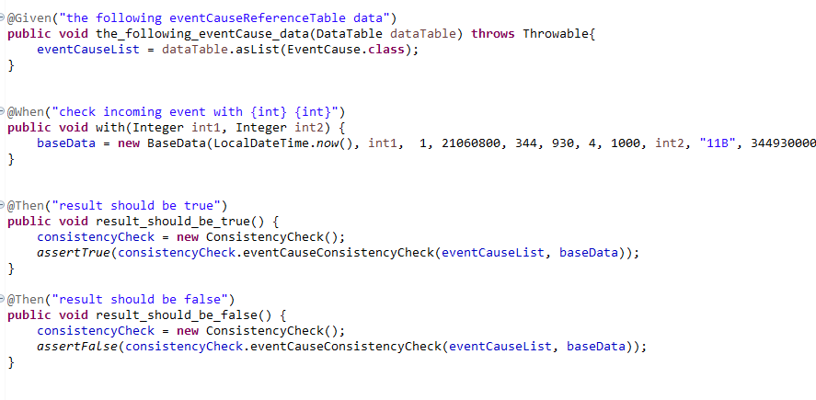
Suggestion On test steps
……

Slide 31
Further test strategy
REST API Layer testing
Can cover a lot of functionality – particularly for queries
UI testing
Manual UI talking to server to develop / integrate
Capture your API
Selenium running towards server
Nirvana – auto generated Stubs for UI to test against mock server– fast UI testing

Slide 32
Further test strategy
REST API Layer testing
Can cover a lot of functionality – particularly for queries
UI testing
Manual UI talking to server to develop / integrate
Capture your API
Selenium running towards server
Nirvana – auto generated Stubs for UI to test against mock server– fast UI testing
Don’t test POJOs
Import – unit test file import

Slide 33
Further test strategy
REST API Layer testing
Can cover a lot of functionality – particularly for queries
UI testing
Manual UI talking to server to develop / integrate
Capture your API
Selenium running towards server
Nirvana – auto generated Stubs for UI to test against mock server– fast UI testing
Don’t test POJOs
Import – unit test file import
At Demo – working SW is key
Plus a statement on test solution

